Slide 1

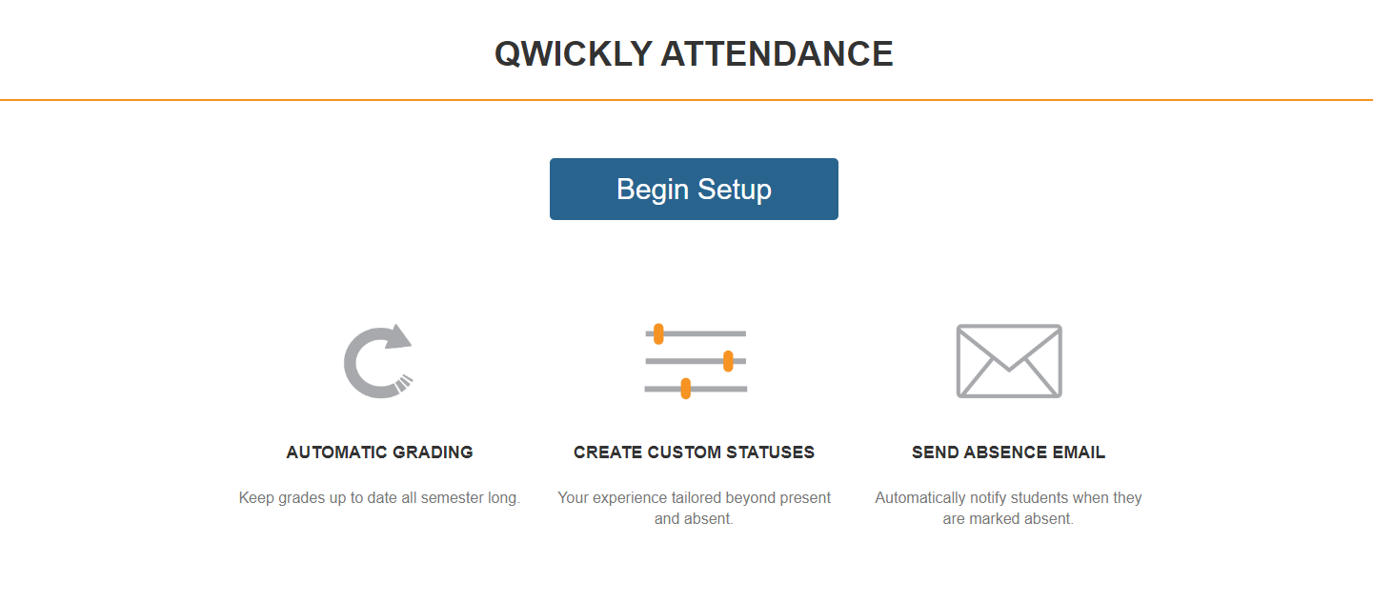
Qwickly Attendance Tool
Getting Started
Step 1: If you have never used the Qwickly Tool before, then you will land on this page after selecting Qwickly Attendance from the Course Tools dropdown.

Slide 2
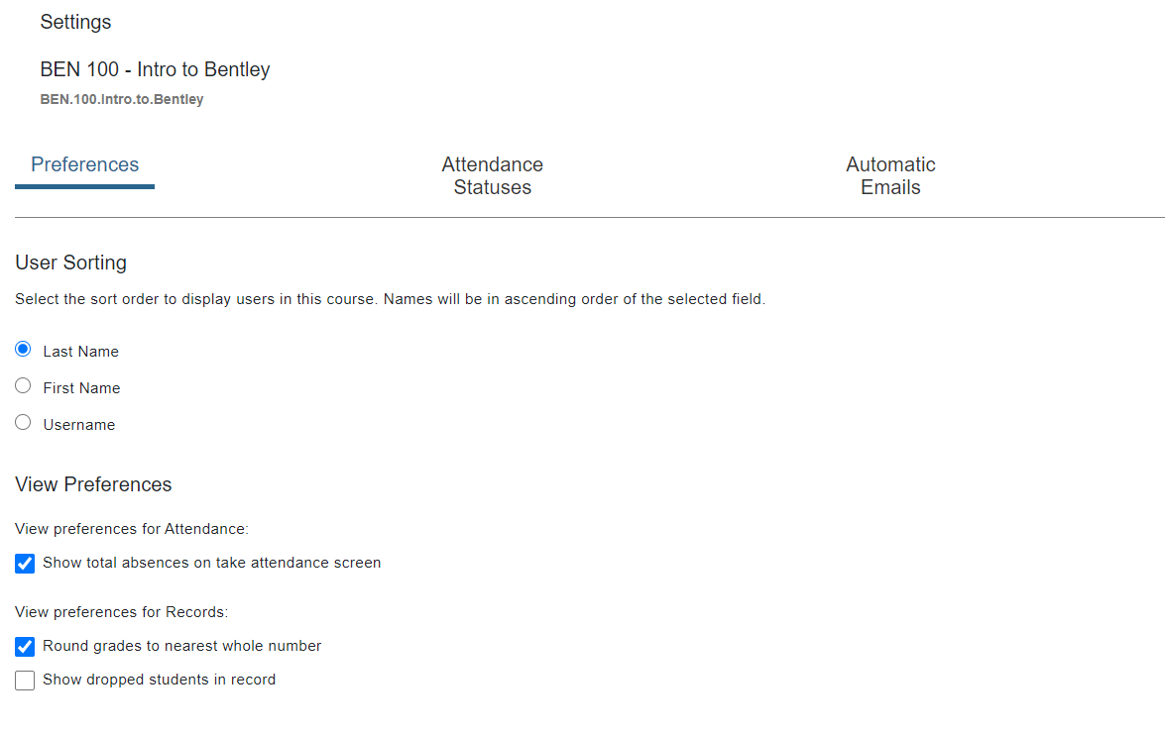
Step 2: You will begin on the Preferences tab of the Settings page for your course.
Select the sort order for your roster and site preferences. You can change these at any time.

Slide 3
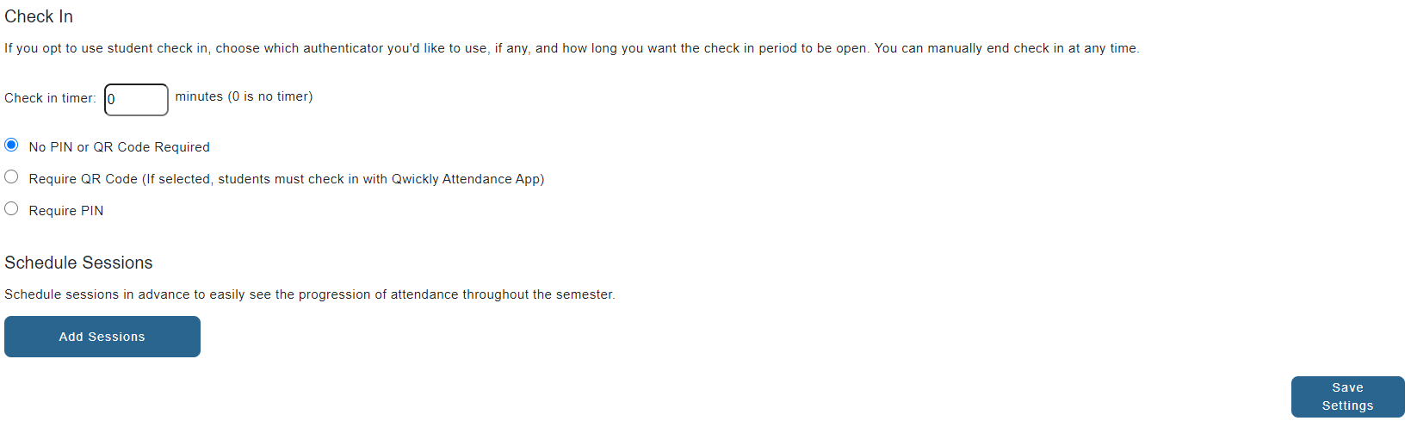
Step 3: Once you selected your preferences, select Save Settings at the bottom of the page.

Slide 4
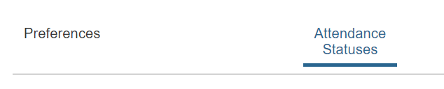
Step 4: Select the Attendance Statuses option at the top of the page.

Slide 5
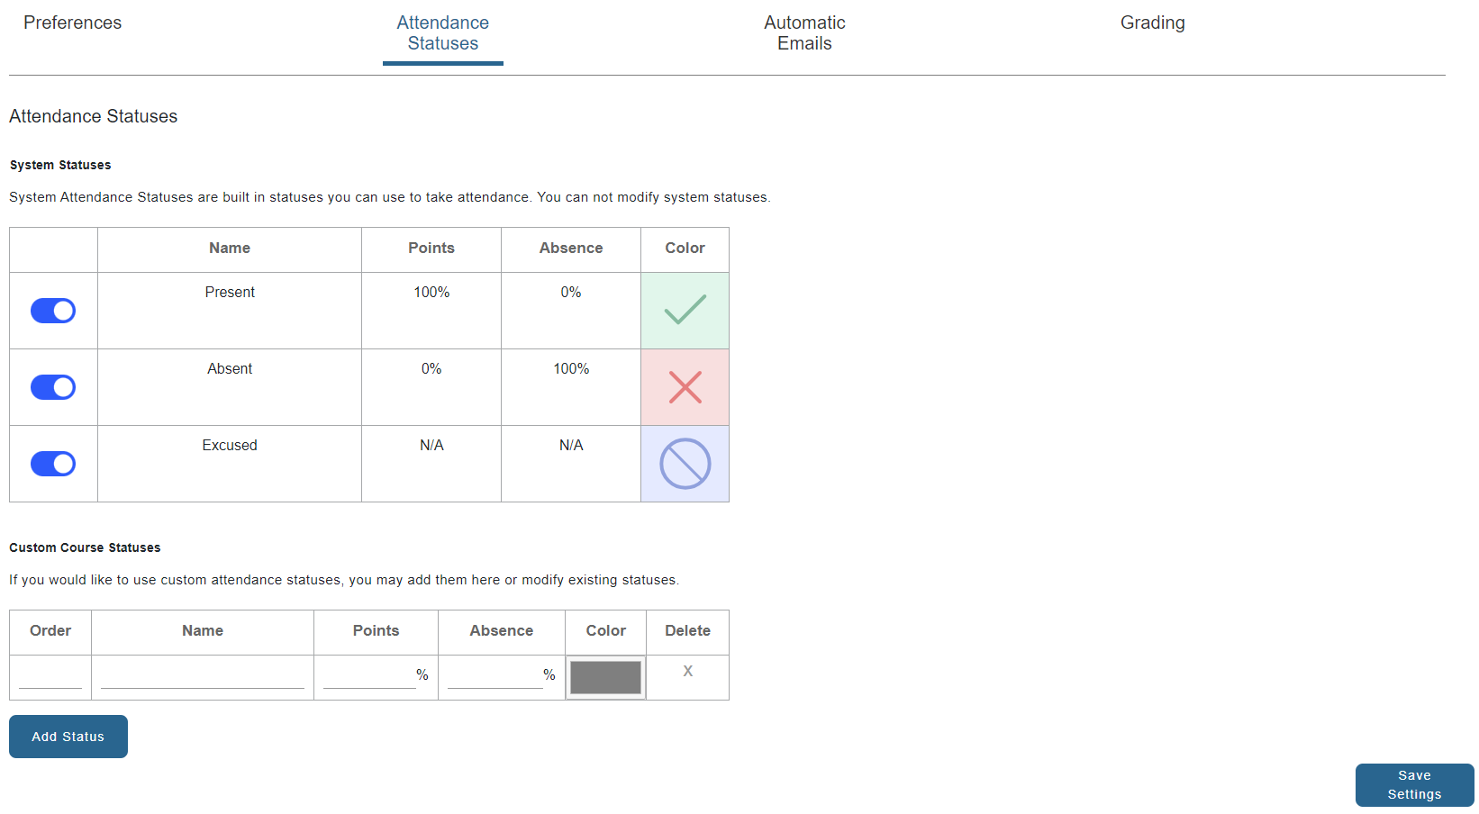
Step 5: There are three default statuses. These three statuses should be used for the Verification of Participation process. You may choose to add additional statuses for your own purposes.

Slide 6

Attendance Statuses
PRESENT: Student attended an in-person or synchronous class meeting, or the student engaged or participated in an online asynchronous course in the first week of classes.
ABSENT: Student did not attend an in-person or synchronous class meeting, or the student did not engage or participate in an online asynchronous course in the first week of classes.
EXCUSED: Student was not able to attend, engage, or participate in the first week of classes BUT contacted the instructor with reasonable explanation (e.g., military requirements, travel issues, illness).

