Slide 1
Presentation Guide | Introduction
This Bentley-branded PowerPoint template was created to help any member of the Bentley community build on-brad, easy-to-read slide presentations.
It assumes that you have basic PowerPoint skills and know how to add new slides, insert content (photos, text, graphics, charts) and that you can manipulate the variable elements of the templates. (If you need more help with PowerPoint, you can reach out to Bentley IT or the ATC or search online tutorials.)
To work with this template, first download and save a copy.
Do not delete any slides or helper text boxes (text in yellow boxes like this one) until you are sure you won’t need them.
Edit existing slides or if need be, insert new slides. This template has more than 25 different templates to work with.
Some templates just require you to add text or insert a photo or chart via PPT tools.
Other slides have editable graphics, i.e., the agenda slides and stat slides (circles, squares). These graphics are NOT part of the template but are included here for your use and / or inspiration. Contact brand@bentley.edu for assistance with these.
Once you are done, you can delete these Presentation Guide slides as well as all of the yellow helper text boxes.

Slide 2






Presentation Guide | Cover Slide Options
These are the six Cover Slide designs in this template. To access, go to Insert > New Slide and choose the design you would like. Note that dark slides are best for projecting, white for printing. The photos, overlays and colors here are fixed in the template’s Master View. We also have two End Slide Options like 1 and 6.

Slide 3






Presentation Guide | Section Divider Options
These are the 5 Section Divider Slide options in this template. To access, go to Insert > New Slide and choose the design / color you would like. You can use any number / color combination you would like but they are designed to correspond with the simple agenda slide.

Slide 4
Agenda
This exact slide is not in the master view. It is a Content Slide template with graphics added to create an agenda.
Tip: To create your own agenda, save this slide and change the text.
01
02
03
SECTION TITLE OR DESCRIPTION HERE
SECTION TITLE OR DESCRIPTION HERE
SECTION TITLE OR DESCRIPTION HERE
04
05
06
SECTION TITLE OR DESCRIPTION HERE
SECTION TITLE OR DESCRIPTION HERE
SECTION TITLE OR DESCRIPTION HERE

Slide 5
Agenda
This exact slide is not in the master view. It is a Content Slide template with graphics added to create an agenda.
Tip: To create your own agenda, save this slide and change the text. Once you have completed your agenda (adding or deleting numbers/rows), you can select the table and hide the lines for a cleaner look.
01 | Section 1 title or longer description text | 07 | Section 07 title or longer description text
02 | Section 2 title or longer description text | 08 | Section 08 title or longer description text
03 | Section 3 title or longer description text | 09 | Section 09 title or longer description text
04 | Section 4 title or longer description text | 10 | Section 10 title or longer description text
05 | Section 5 title or longer description text | 11 | Section 11 title or longer description text
06 | Section 6 title or longer description text | 12 | Section 12 title or longer description text

Slide 6
Here is an example of what you can do with the Content Slide template.
Tip: To ensure you are using brand colors in your chart, go to bentley.edu/brand/visual-identity#colors.

Slide 7
Here is an example of what you can do with the Content Slide template.
Tip: The circles can be deleted or moved or changed from %.
00%
00%
00%
00%
00%
Subtext for description of
the stats
Subtext for description of
the stats
Subtext for description of
the stats
Subtext for description of
the stats
Subtext for description of
the stats

Slide 8
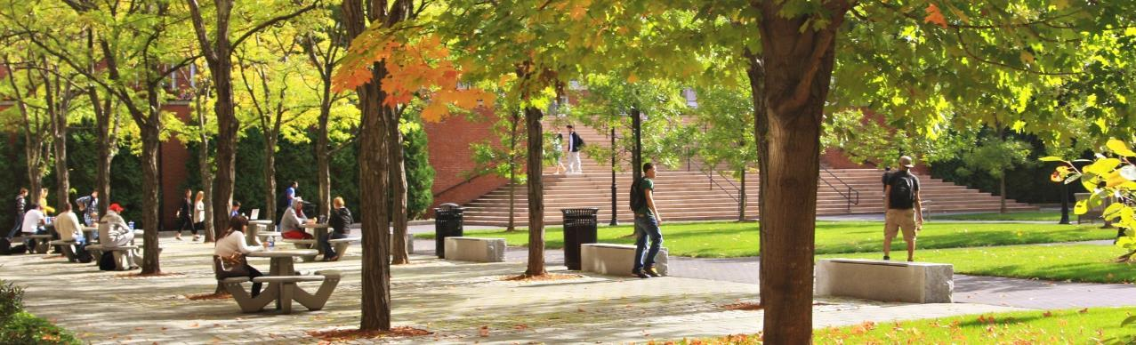
Here is an example of what you can do with the Photo Slide with Stats template.
Tip: The circles can be deleted or moved or changed from %.
Tip 2: To replace photo, delete, then click on icon to insert picture. To alter placement, click photo, select Picture Format > Crop.
00%
00%
00%
00%
00%
Subtext for description of
the stats
Subtext for description of
the stats
Subtext for description of
the stats
Subtext for description of
the stats
Subtext for description of
the stats

Slide 9
Why Bentley?
This is an example of what you can do with a Simple Title Photo template. Use as a presentation cover or section divider or info slide.
Tip: The headline and copy can be edited but the background photo can only be changed in the Master View.
Bentley University is a leading business university renowned for its world-class faculty across an array of business disciplines. The institution is a recognized innovator with regards to curriculum – incorporating business, technology, and the arts and sciences into the classroom.

Slide 10
The History of Bentley University
This is an example of a Content Slide – Historical Photo Light template. (There are 2 other versions with different photos.)
Tip: The copy can be edited but the background photo can only be changed in the Master View.
More Than a Century of Reinventing Business Education
When Harry C. Bentley first convened a class of 30 students on Huntington Avenue in Boston in 1917, his goal was to educate the next generation of accountants. Since opening our doors over 100 years ago, Bentley University has continuously reinvented business education and grown from those humble beginnings to become one of the top business universities in the U.S.
As a transformative lifelong-learning community, we prepare over 5,000 undergraduate and postgraduate students each year to use their business know-how to make a positive difference in the world. With a community of over 65,000 proud Falcon alumni, the impacts of a Bentley education stretch around the globe.

Slide 11
Here is an example of what you can do with the Content – 2 Columns template.
BODY COPY OR FACTS. Ut que endandit maio cusciumquia ducim ellignatis erum estiandi ad que porestis aut eos nim archit acerum ditione derum audae perum nis quostiae eario verupta doluptatasi aut qui od magnimolupta qui consequidem. Nam faceatur.
Ut que endandit maio cusciumquia ducim ellignatis erum estiandi ad que porestis aut eos nim archit acerum ditione derum audae perum nis quostiae eario verupta doluptatasi aut qui od magnimolupta qui consequidem. Nam faceatur.
BODY COPY OR FACTS. Ut que endandit maio cusciumquia ducim ellignatis erum estiandi ad que porestis aut eos nim archit acerum ditione derum audae perum nis quostiae eario verupta doluptatasi aut qui od magnimolupta qui consequidem. Nam faceatur.
Ut que endandit maio cusciumquia ducim ellignatis erum estiandi ad que porestis aut eos nim archit acerum ditione derum audae perum nis quostiae eario verupta doluptatasi aut qui od magnimolupta qui consequidem. Nam faceatur.

Slide 12




Here is an example of what you can do with the Content – Split Left template.
Tip: Visit bentley.edu/brand to download the full brand icon library.
Aut eos nim archit acerum ditione derum audae perum nis quostiae.
Aut eos nim archit acerum ditione derum audae perum nis quostiae.
Aut eos nim archit acerum ditione derum audae perum nis quostiae.
Aut eos nim archit acerum ditione derum audae perum nis quostiae.

Slide 13
Here is an example of what you can do with the Content – Split Left Wide template.
Tip: On the left, you can insert text, a table or graph or a photo or video. On the right, you can use these graphics or others.
00
Subtext for description of
the stats
00
Subtext for description of
the stats
00
Subtext for description of
the stats

Slide 14
A National Leader
#1
98%
Undergraduate Career Services
Job
Placement Rate
The Princeton Review
Career Services
$73k
#1
Median Starting Salary
Most Innovative
Regional North
Career Services
U.S. News & World Report
Here is an example of what you can do with the Content – Split Half template.
Tip: On the left, you can insert text, and on the right, graphics like these or a table or graph, a photo or video.

Slide 15
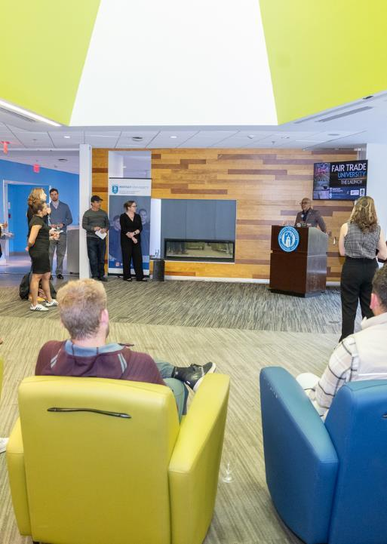
Bentley named a Fair Trade University
Here is an example of what you can do with the Content – Text and Photo template.
Tip: On the left, you can insert text, and on the right, a photo. To replace the photo here, delete, then click on icon to insert new picture. To alter placement, click photo, select Picture Format > Crop.

Slide 16





Here is an example of what you can do with the Photo Collage template.
Tip: To replace the photos here, delete, then click on icons to insert new pictures. To alter placement, click photo, select Picture Format > Crop.

